Slide 1
CTIT IMAGE QUALITY DETECTION

Slide 2
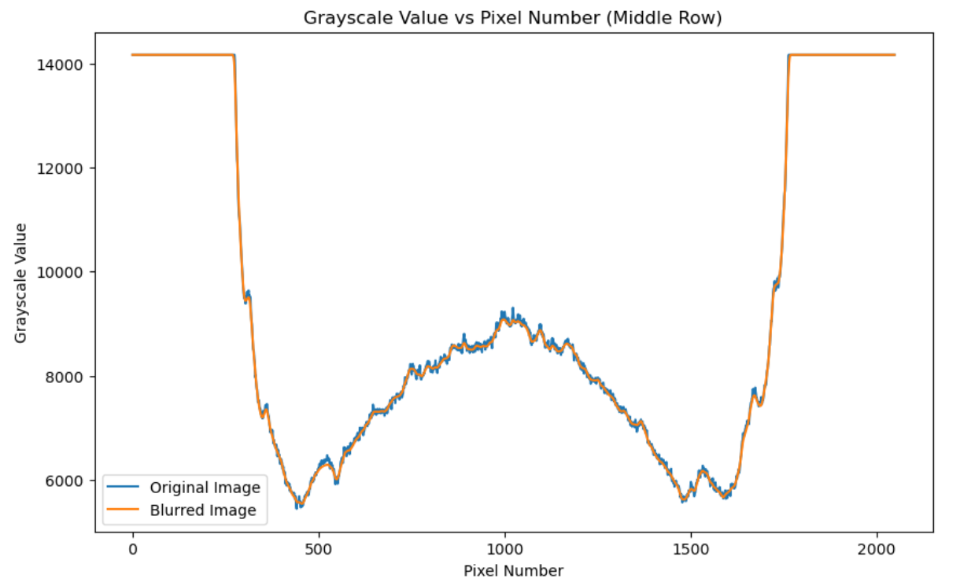
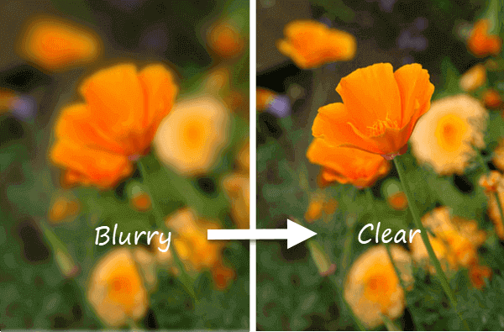
Bad Image Quality
Sudden shift in intensity
Image lacking sharpness (i.e., Blurry Image)
Unintentional alteration in setup.

Slide 3
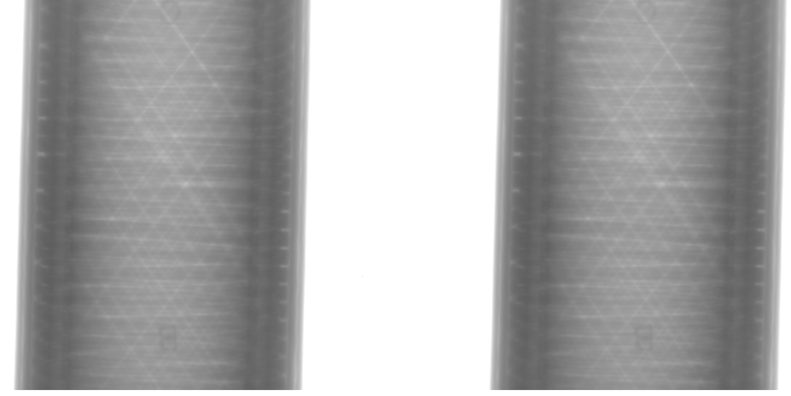
Method:
Aim: Keep on capturing the image and simultaneously check for quality of Image.
Assumption: First captured image is of good quality.
Image-1
Image-2
To best assess image quality, we have opted to compare it with the previous image.
Used MSE and Laplacian variance to detect bad quality images.

Slide 4
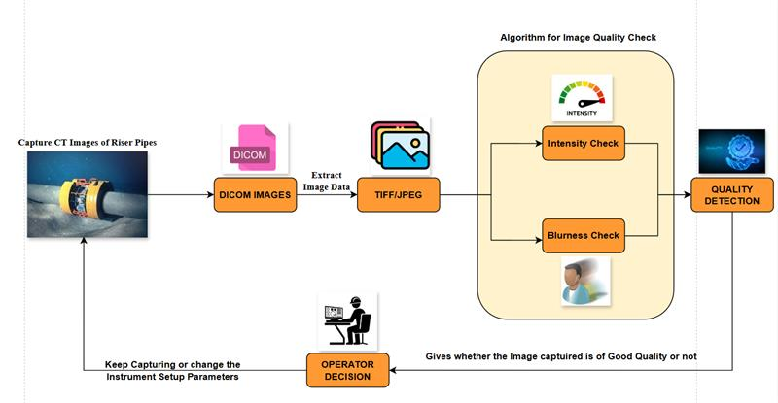
CTIT Automatic Image Quality Inspection Workflow

Slide 5
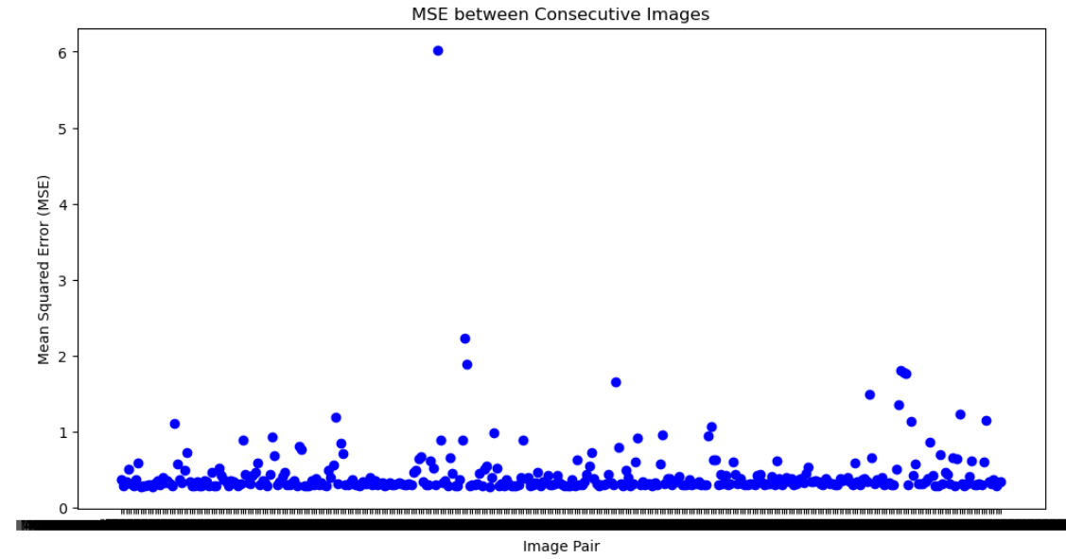
Calculated MSE for each consecutive image of a dataset.
IMG00130 & IMG00131
IMG00141 & IMG00142
IMG00142 & IMG00143

Slide 6
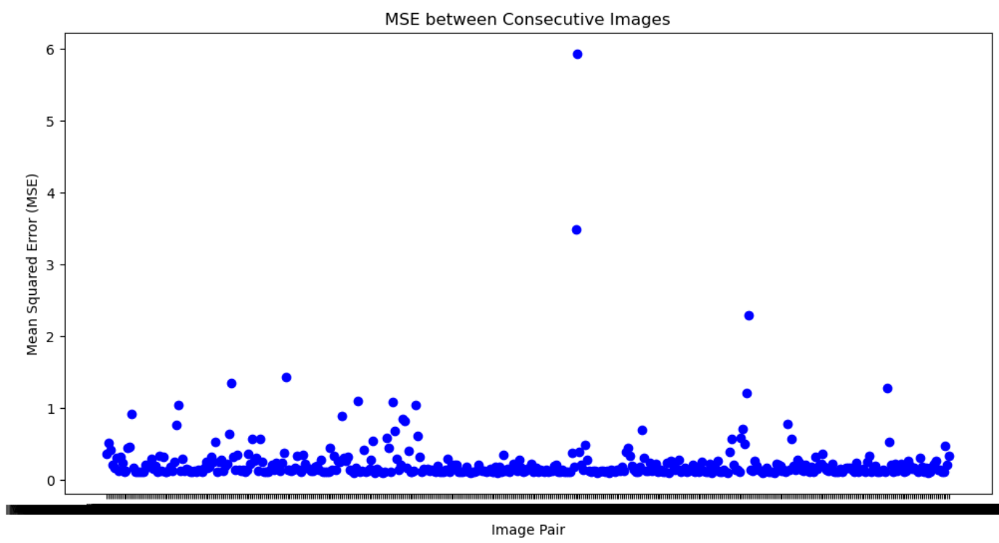
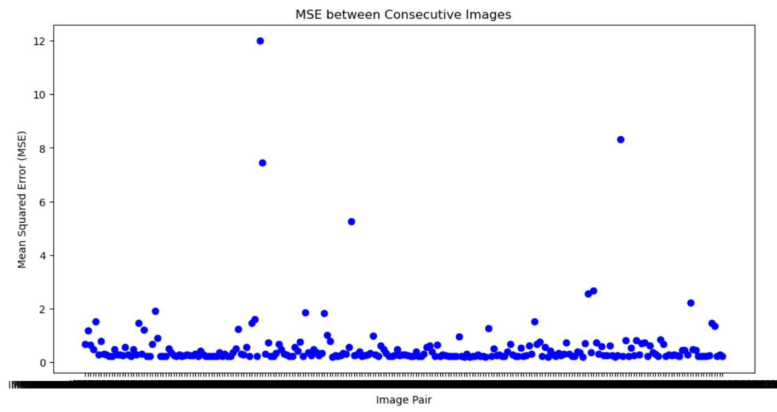
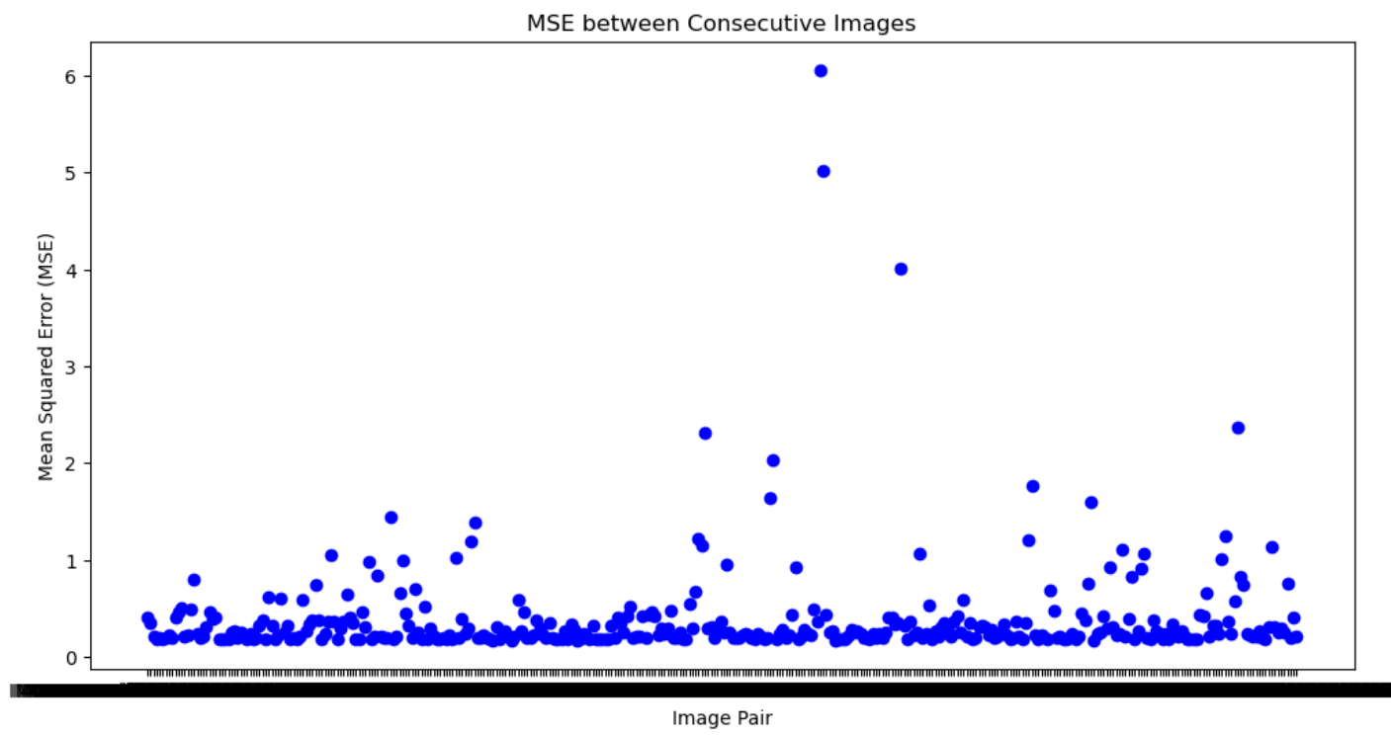
Dataset-1
Dataset-2
Dataset-3

Slide 7
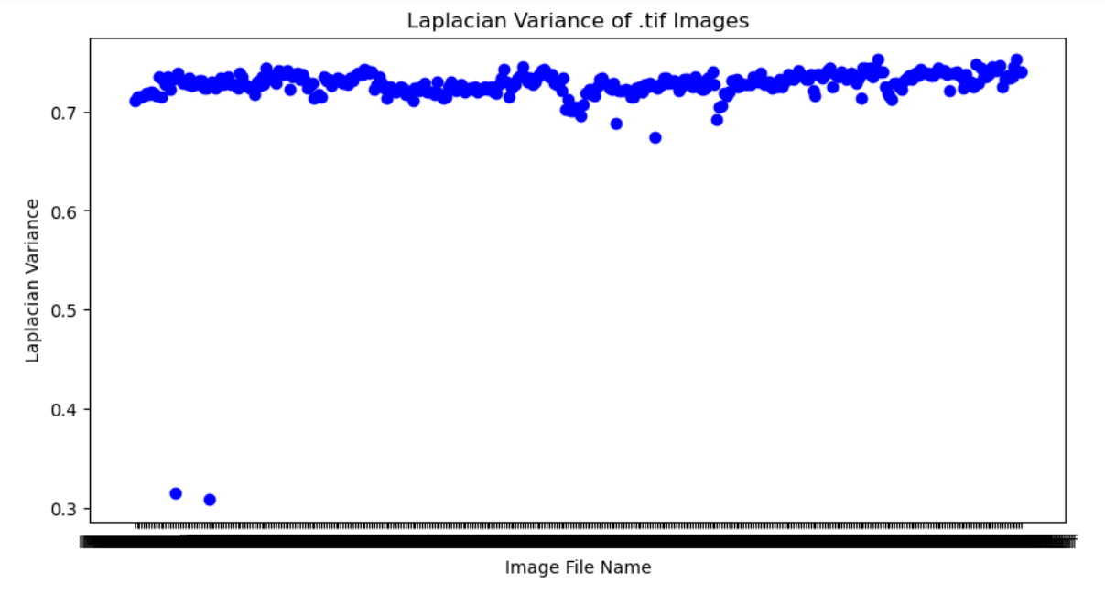
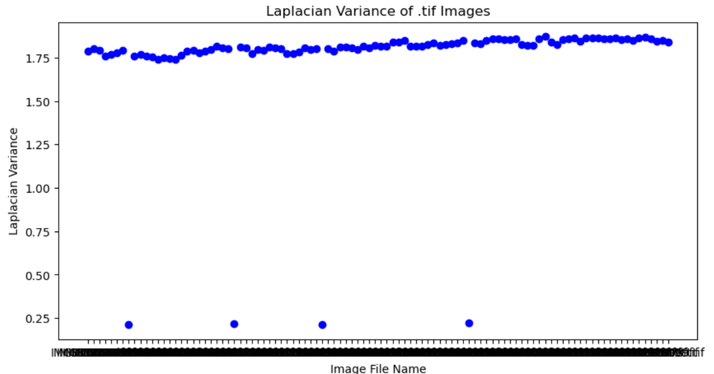
Blurred Image Detection

Slide 8
